Slide 1

MINI PROJECT
Group Members
Aniket Dhiman (2021A1R172)
Vinayak Bhardwaj (2021A1R157)
Ayush Dhotra (2021A1R182)
DEPARTMENT OF COMPUTER SCIENCE AND ENGINEERING
MIET(Autonomous), JAMMU

Slide 2
IOT BASED LANDSLIDE DETECTOR

Slide 3
Problem Statement:
Current Challenges in Landslide Detection Need for Automated and Efficient Detection Systems.

Slide 4
INTRODUCTION
Objective:
The main goal of our project is to create a soil moisture monitoring system that uses two moisture sensors and an Arduino microcontroller to show readings in real time. Our goal is to identify the ideal moisture threshold for various soil types by examining the soil moisture levels.
Importance:
Early warning system of landslide will be more accurate by monitoring the changes of ground water condition

Slide 5
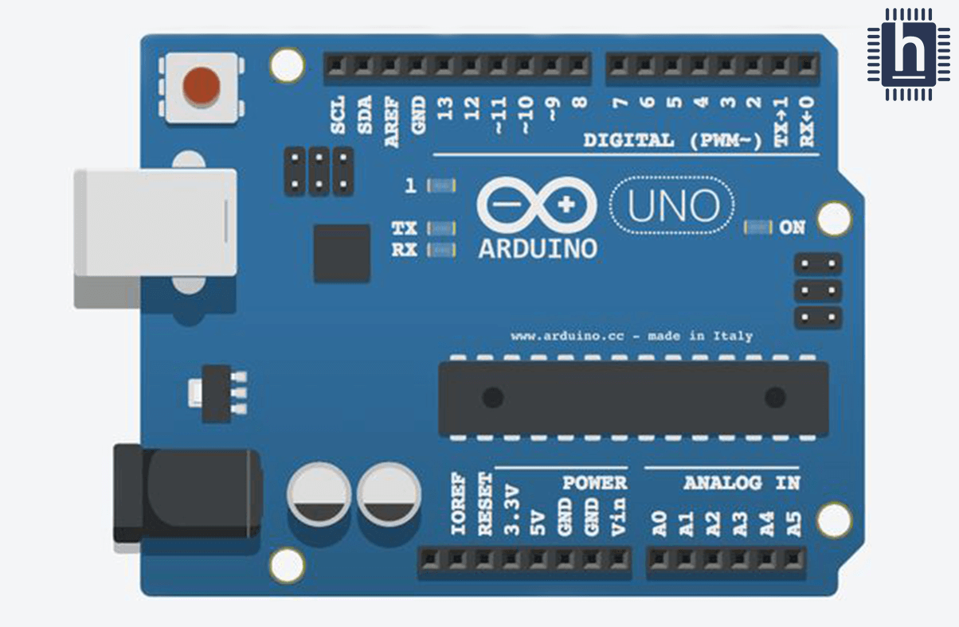
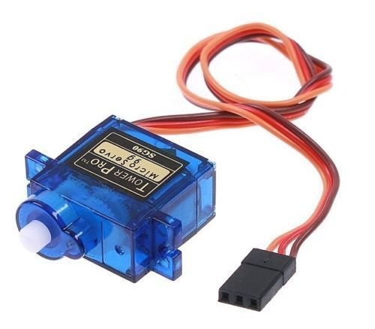
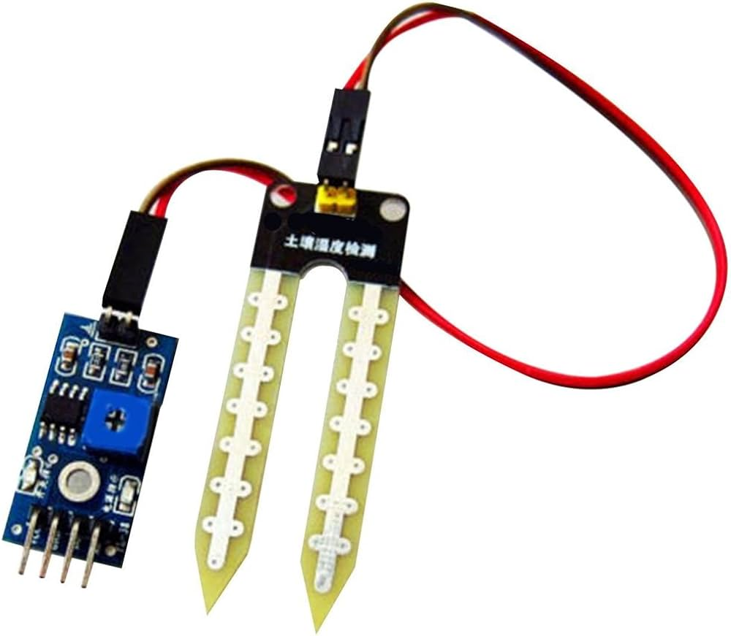
SYSTEM OVERVIEW
COMPONENTS:
Arduino UNO
Servo Motor
Bread Board
Moisture Sensor
DHT 11

Slide 6
ARDUINO MICROCONTROLLER
The Arduino microcontroller collects data from the soil moisture sensors via its analog input pins. The sensors measure soil moisture levels and output an analog voltage signal proportional to the moisture content.
The Arduino reads these analog signals, converts them to digital values using its built-in Analog-to-Digital Converter (ADC), and processes the data by comparing it to predefined moisture thresholds. Based on this comparison, the Arduino triggers alarms or controls gate mechanisms to mitigate landslide risks. This real-time data processing and decision-making ensure timely alerts and actions

Slide 7
SOIL MOISTURE SENSOR
Soil moisture sensors measure or estimate the amount of water in the soil. These sensors can be stationary or portables such as handheld probes.
Stationary sensors are placed at the predetermined locations and depths in the field, whereas portable soil moisture probes can measure soil moisture at several locations

Slide 8
REAL TIME MONITORING
The Arduino reads soil moisture sensor data and displays the real-time readings on an LCD using the Liquid Crystal library. The sensor values are converted to a percentage and updated on the LCD screen.
Simultaneously, the Arduino uses a Bluetooth module (e.g., HC-05) to send the sensor data to paired smartphones. An app or terminal on the phone receives the Bluetooth signals, displaying real-time moisture levels. This dual-display system ensures easy monitoring both on-site and remotely

Slide 9
EARLY LANDSLIDE DETECTION
MECHANISM
When moisture levels exceed the threshold, the moisture sensor sends a higher analog voltage to the Arduino Uno. The Arduino reads this signal, converts it to a digital value, and compares it to the predefined threshold.
If the threshold is breached, the Arduino triggers an alert, updates the LCD screen to show a warning message or the high moisture value, and will also activate alarms and gates. This ensures immediate visual and operational responses to potential landslide risks

Slide 10
AUTOMATED GATE CONTROL
When the moisture sensor detects levels above the threshold, the Arduino triggers a buzzer and sends a signal to a connected servo motor. The servo motor, programmed to rotate 90 degrees, closes the gate to block the road.
This mechanism stays engaged, keeping the road shut to prevent access until the landslide risk is mitigated and the system is reset. This automatic response ensures safety by preventing vehicles and pedestrians from entering dangerous areas

Slide 11
BENEFITS
The system enhances safety in vulnerable regions by using an Arduino Uno to monitor soil moisture levels with sensors. When thresholds are exceeded, the Arduino activates a buzzer to alert stakeholders, updates an LCD display with real-time warnings, and sends a signal to a servo motor.
The servo motor then closes a gate, preventing access to dangerous areas. This integrated approach ensures timely alerts and automatic road closures, mitigating landslide risks and protecting lives and property

Slide 12
CHALLENGES
Power Supply Reliability: In remote hilly areas, maintaining a consistent power supply for the Arduino Uno, servo motor, and buzzer can be challenging, especially during adverse weather conditions.
Signal Interference: The rugged terrain may cause interference or signal loss in the sensor data transmission and wireless communications, affecting the system's reliability and accuracy.
Environmental Durability: Harsh weather conditions, such as heavy rain, mud, and landslides, can damage the electronic components and sensors, necessitating robust waterproof and dustproof housing.
Maintenance and Accessibility: Regular maintenance and timely repairs can be difficult in hilly regions due to limited accessibility and the need for specialized skills to service the system

Slide 13
SOLUTION
Alternative Power Sources: Implement backup power sources such as solar panels or rechargeable batteries to ensure continuous operation during power outages or unreliable grid supply.
Signal Amplification and Redundancy: Install signal amplifiers or repeaters to enhance data transmission reliability, and consider using multiple communication channels (e.g., Bluetooth, LoRa, GSM) for redundancy.
Ruggedized Enclosures: Utilize sturdy, weatherproof enclosures to protect electronic components from environmental damage, ensuring they remain operational despite exposure to harsh weather conditions.
Remote Monitoring and Diagnostics: Incorporate remote monitoring capabilities and diagnostic tools that allow system administrators to assess performance and troubleshoot issues remotely, reducing the need for physical access and specialized maintenance expertise.

Slide 14
CONCLUSION
Life-saving Potential: Landslides pose a significant threat to human life and infrastructure, especially in hilly or mountainous regions. By detecting potential landslides early and triggering the closure of gates, this project could prevent disasters and save countless lives.
Infrastructure Protection: Beyond human safety, landslides can cause extensive damage to roads, buildings, and other infrastructure. By closing gates in vulnerable areas, the project can help minimize the destruction caused by landslides, reducing repair costs and preventing disruptions to transportation and communication networks.
Community Resilience: Implementing a landslide detection system fosters community resilience by empowering local residents and authorities to respond proactively to natural hazards. When people feel safer in their environment, they're more likely to invest in the long-term sustainability and development of their communities.

Slide 15
CONCLUSION
4. Accessible Technology: Using Arduino Uno and relatively inexpensive components makes this project accessible to a wide range of communities, including those with limited resources. By democratizing the technology behind landslide detection, this project can benefit even the most vulnerable regions prone to natural disasters.
5. Real-time Monitoring: The inclusion of an LCD display to show warning messages and moisture levels at four different points adds another layer of sophistication to the system. Real-time monitoring allows for timely responses and adjustments based on changing environmental conditions, enhancing the effectiveness of the landslide detection system

Slide 16


Slide 17


